Slide 2
ABOUT DCS
Founded in 1986
65M+
1000+ Clients
and 10%
are listed companies
350+
of Thai citizens
use our products everyday directly and indirectly
professionals
Enterprise Systems Infrastructure
Data & Analytics
Digital Product
Development Service
Digital Business Transformation
Datacenter
Modernization
Cloud Technology
Platform
Cyber Security
Operation Transformation

Slide 3
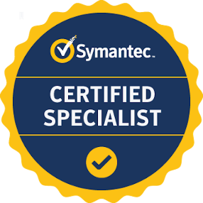
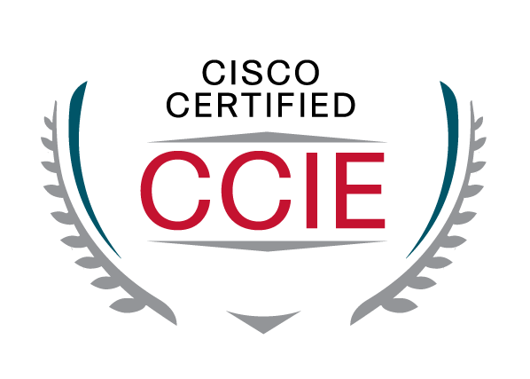
ABOUT DCS
Global standard certifications for our services
ISO 20000 IT Service Management
ISO 27001 Information Security Management
Gold Level with CISCO
Over 100 world class certified professionals such as CISSP, CCIE, CISA, Certified specialist

Slide 4
D-WorkTM : Human Capital Management
Organizational
Employee Management
Recruitment Management
Benefit Administration
Time Attendance
Payroll processing
Reimbursement
Training Administration
Competency & Performance
Self Service
Products & Services Structure
Infrastructures Management
IT Service Management
Data Center Automation
Workload Automation
Governance, Risk, and Compliance
Application Full Outsource Management
Robotic Process Automation
Business Development & IT Operation
Human Capital Management Solution
Business Service Management Software
Enterprise Application Managed Services
Enterprise Systems & Infrastructure
Information Technology Services
Professional Multimedia Solutions
Digital Content Innovation
Data Center Infrastructure
Networking & Security Infrastructure
Cyber Security Solutions
Database Migration Service
Back up & DR Solutions
Application Development Service
IT Managed Services
Data Center
Co-location Hosting
Service Desk Support
LCD, DLP and LCOS Projector
LCD TV & LCD Monitor
Projection Screen
Interactive Display
Display Management System
HDVC Live Solution
Large format Printer
Service Center
Digital Content Services
Streaming Content Management

Slide 5
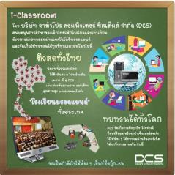
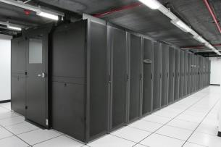
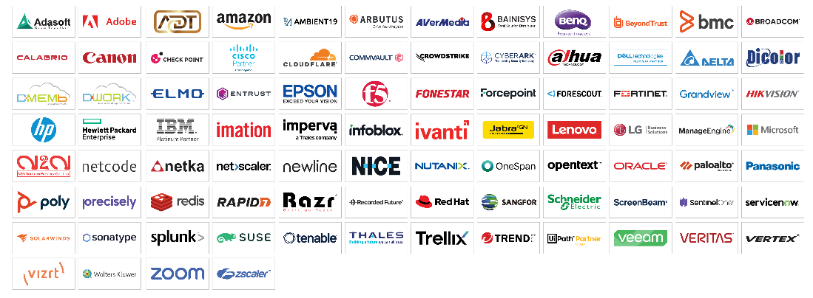
PRODUCTS & SERVICES
Hardware & Software
Professional Services
Managed Services

Slide 6
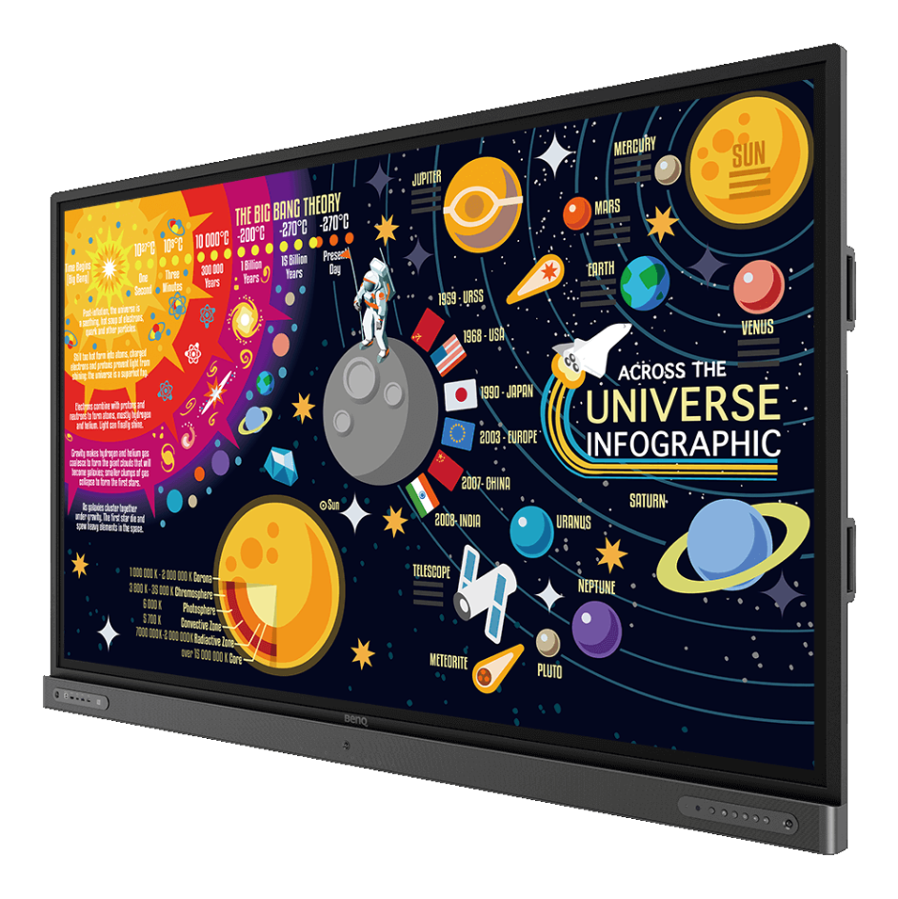
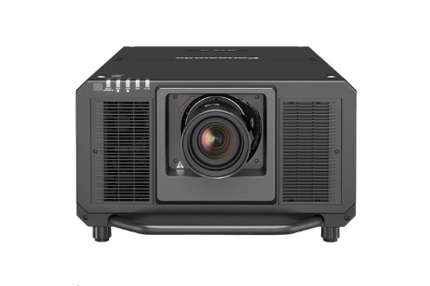
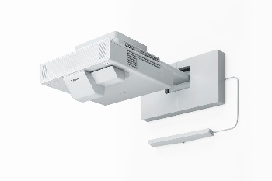
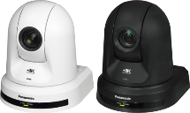
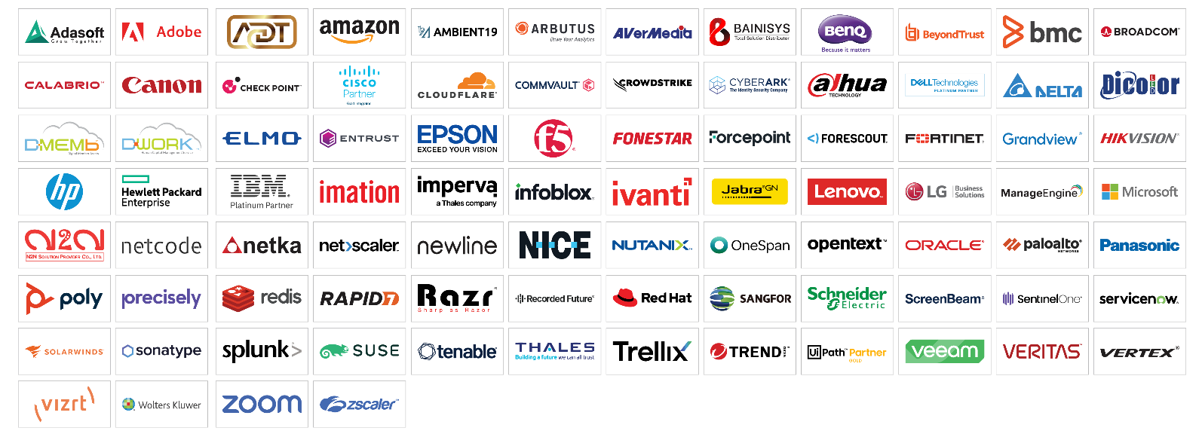
PRODUCTS & SERVICES
Hardware & Software
Hardware
IT Products
Multimedia Products
Digital Content Products
Software
Application Software
Tools & Utilities
Database & Operating Systems

Slide 7
PRODUCTS & SERVICES
Software as a Service (SaaS)
Human Capital Management
Business Service Management Software
Robotic Process Automation
Low-code Platform
Security Infrastructure Software
Backup & Recovery Software
Service Provider License (SPLA)
Retail Application

Slide 8
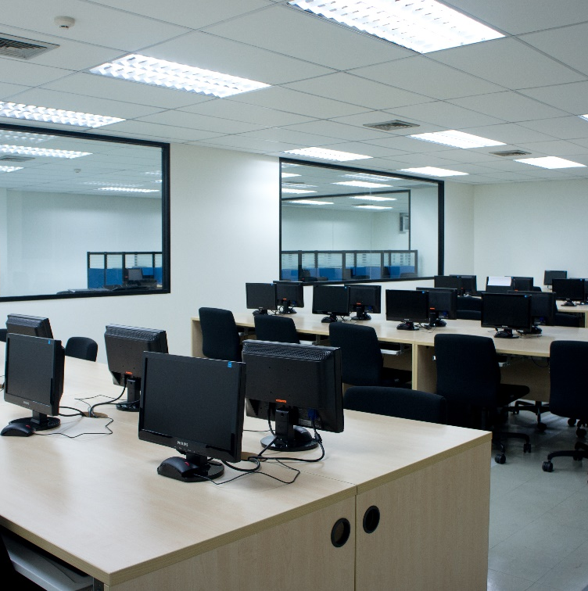
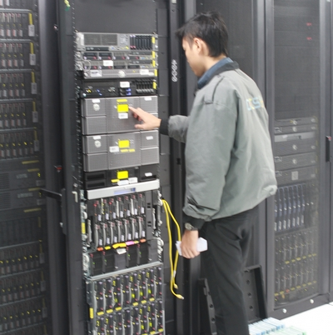
PRODUCTS & SERVICES
Disaster Recovery / Business Continuity
Data Center Facilities
Office Continuity
Disaster Recovery Services
Professional Services
Disaster Recovery / Business Continuity
Application/Technical Support
Application and Development
Consulting & Implementation Services
Training Service
Multimedia product service center
Display Products Rental Services

Slide 9
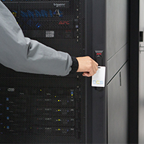
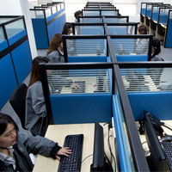
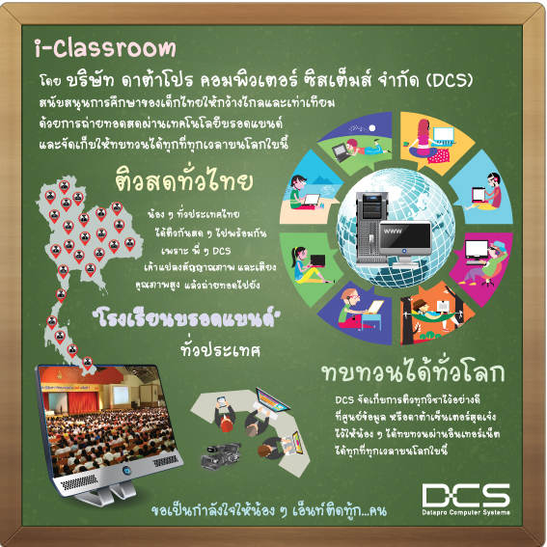
PRODUCTS & SERVICES
IT Outsourcing Services
IT Managed Services
IT Infrastructure
Cloud Services
End-user support services
Infrastructure as a Service
Data Center Co-location Services
Maintenance Services
HW & SW Maintenance
Preventive Maintenance

Slide 10
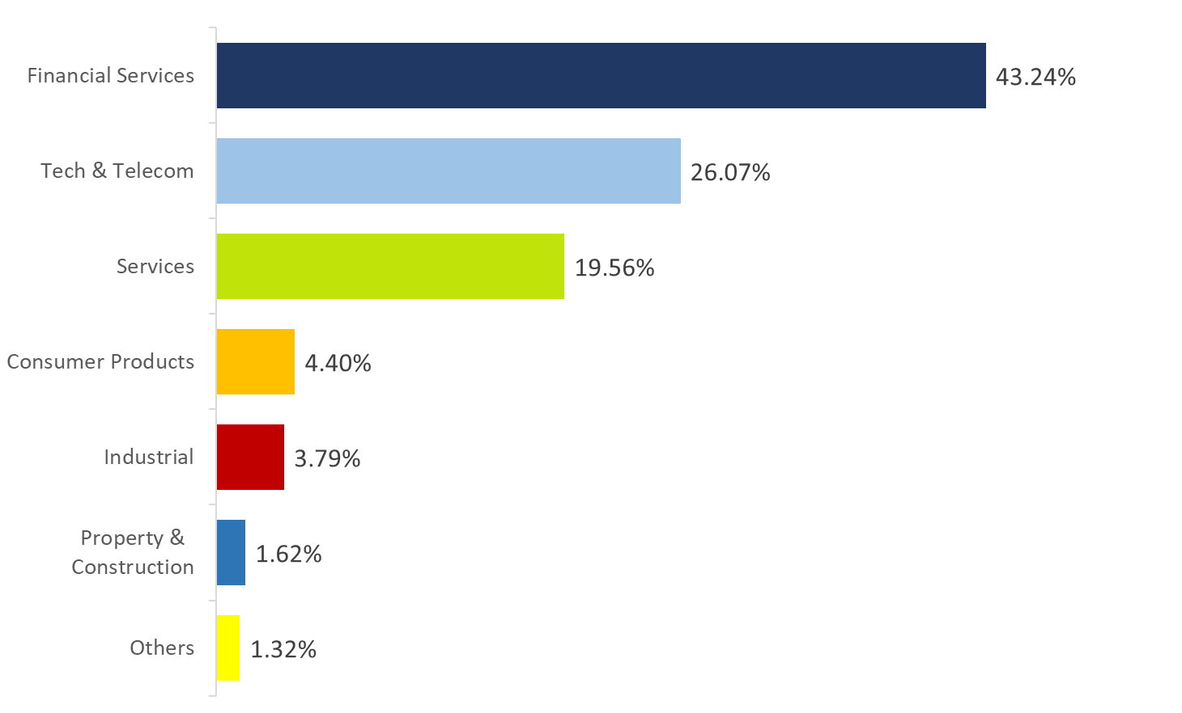
OUR CUSTOMERS

Slide 11
DCS Sales 2018-2022
Amount in Million Baht

Slide 12
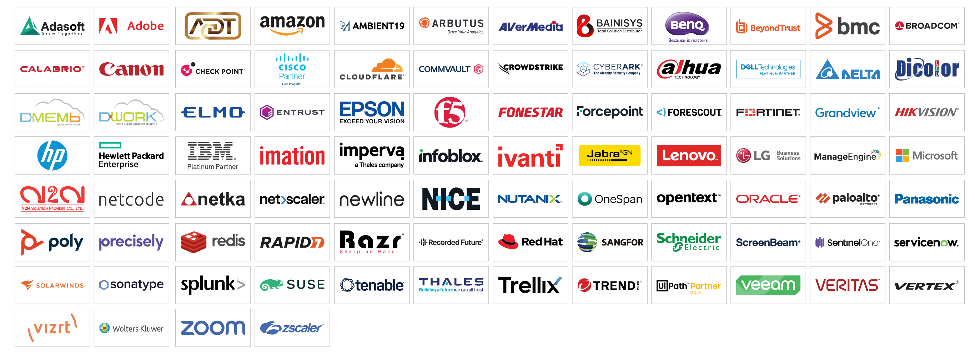
OUR PARTNERS

Slide 13
WHY DCS ?

Slide 14
WHY DCS ?
Over 35 years of experience and knowledge in Enterprise IT Environment
IT Solution Based provider
After sales supports & services for all represented products
Well-trained Professional Staffs
Strong partnerships with world-class IT venders ie IBM, HP, Cisco, Dell, BMC, Oracle, Broadcom, etc.

Slide 15
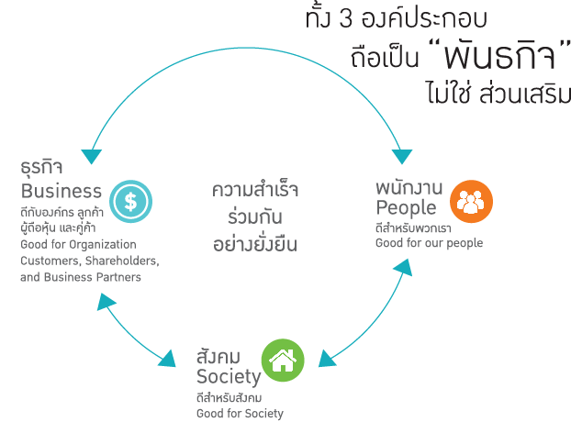
OUR CULTURE
Notes:
การพัฒนาความยั่งยืน มุ่งเน้นเรื่องการสร้างสมดุลของความสำเร็จร่วมกันของทุกภาคส่วน

Slide 16
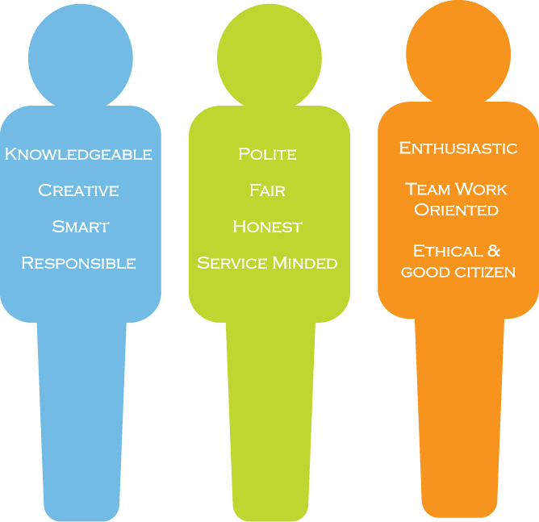
OUR CHARACTERISTICS
Dedicated to Service Excellence

Slide 17
T H A N K Y O U

Slide 18
OUR PREMISES
Head Office
Branch I
Eastern Expansion
2 Premier Place, Srinakarin Road
Bangkok Insurance/ YWCA Building, South Sathorn Road
Pinthong Industrial Estate

Slide 19
Chairman of
the Executive Committee
Wanna Kolsrichai
Enterprise Systems & Infrastructure Business
Digital Solutions Business
Corporate Support
Sidthakorn Usanno
Managing Director
Wanna Kolsrichai
Managing Director (Acting)
Server & Storage
IT Managed Service &
Application Managed Service
Marketing & Corporate
Communications
Organizational Structure
Network Infrastructure
Delivery & IT Service
Management
Legal & Business Practice
Management
Security Infrastructure
Professional Multimedia Solutions
Human Resources
Software Development
Finance & Administration
Eastern Expansion Linkage
Strategic Management Group

